Slide 1
Disparity Map Elaboration Using
CNET Neural Network

Slide 2
Disparity Maps
Time of Flight Cameras
Radars
…
Stereo Cameras
Stereo Cameras

Slide 3
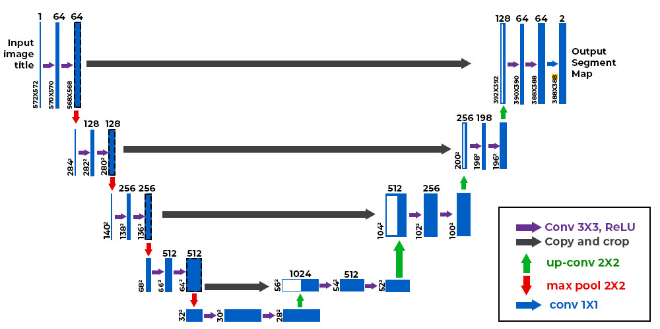
U-Net Network

Slide 4
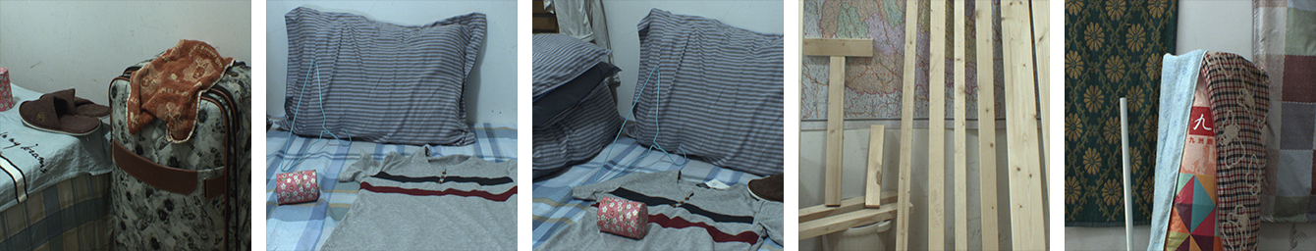
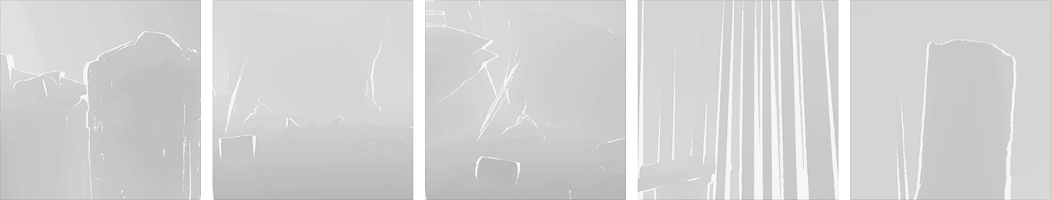
Dataset

Slide 5
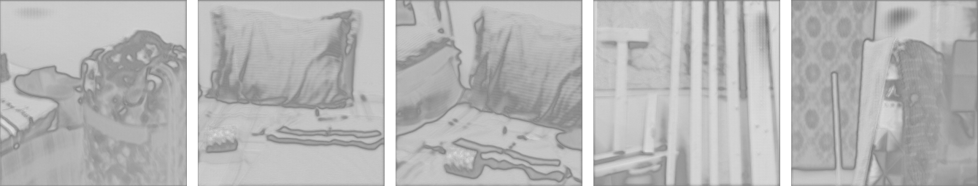
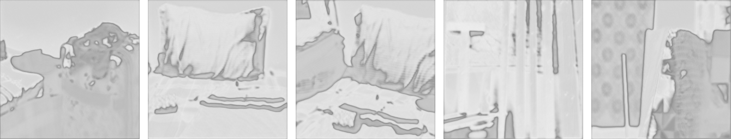
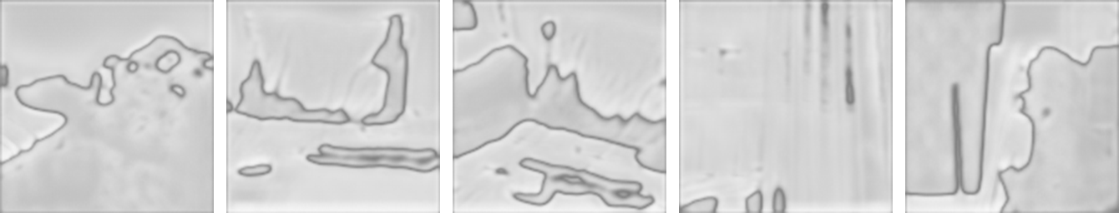
Results
BCEWithLogits Loss (256x256) 10 epochs
MSE Loss (256x256)
10 epochs
BCEWithLogits Loss (128x128) 30 epochs

Slide 6

Conclusions
R
U-Net
30%
60%
L

Slide 7
Thanks for the attention!

Slide 8
Sources
U-net for Image Segmentation: https://arxiv.org/abs/1505.04597
U-net implementation from scratch: https://github.com/aladdinpersson/Machine-Learning-Collection/tree/master/ML/Pytorch/image_segmentation/semantic_segmentation_unet
U-net simple explenation: https://www.youtube.com/watch?v=NhdzGfB1q74&t=558s
Disparity Maps Dataset: https://github.com/YuhuaXu/StereoDataset?tab=readme-ov-file

